Slide 1
Craft of Data Visualization
Dimension reduction for data visualization
Alexey Zaytsev,
Skoltech, CDISE
17 January
Some slides by Evgeny Burnaev are used
Also Ermek Kapushev helped during the preparation of these slides

Slide 2
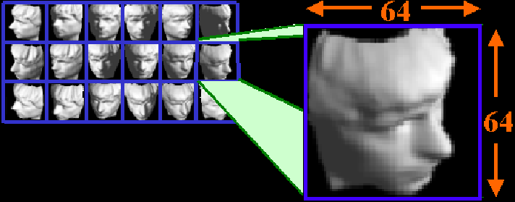
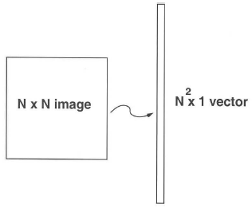
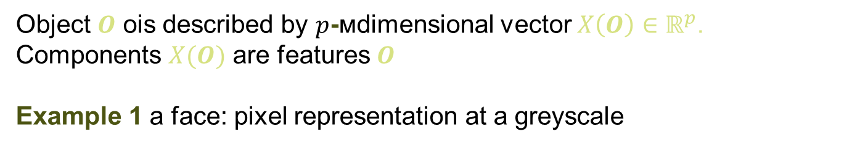
Dimensionality Reduction Problem
Object $O$ оis described by $p$-мdimensional vector $X\left(O\right)∈ℝ^{p}$. Components $X(O)$ are features $O$
Example 1 a face: pixel representation at a greyscale
1024
1024
Face is represented by 1024×1024 pixels –
dimension p = 10²⁰ ~ 1 000 000
2

Slide 3
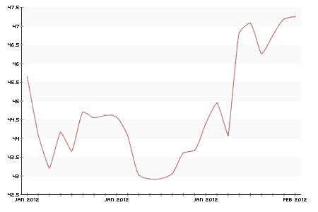
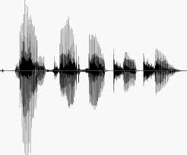
Multidimensional time series
Electricity price
Speech recognition
A curve f(x) is a vector
$$f={\left(f_{1},…, f_{p}\right)}^{⊤}∈ℝ^{p}, f_{j}=f\left(t_{j}\right)$$

Slide 4
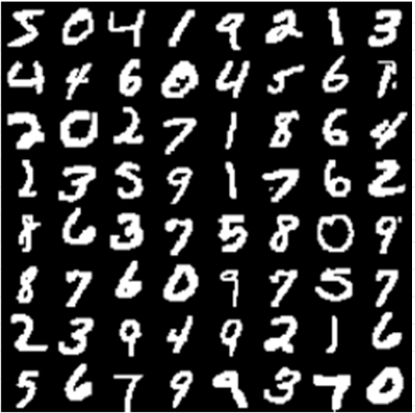
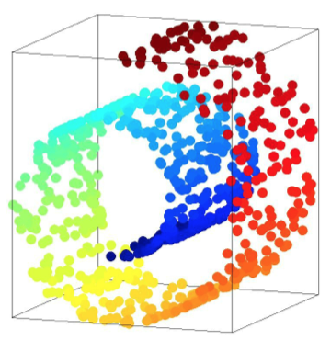
Example 2 (MNIST)
Example 3 Toy “Swiss Roll” Problem

Slide 5
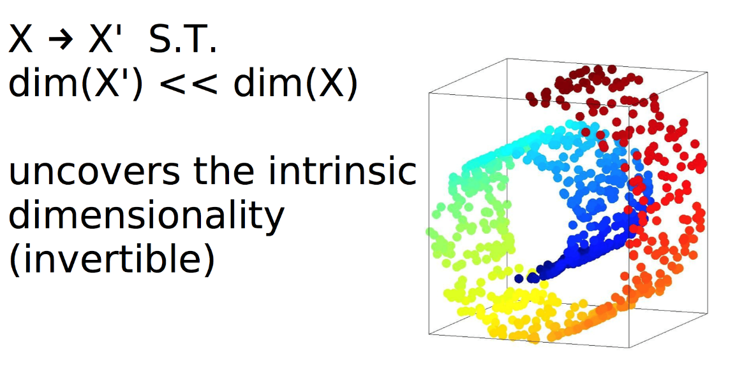
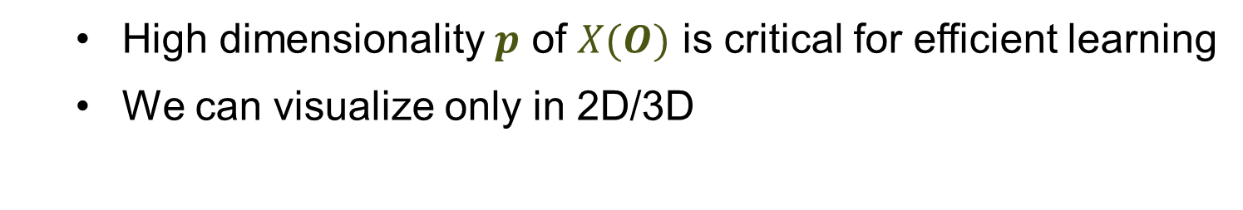
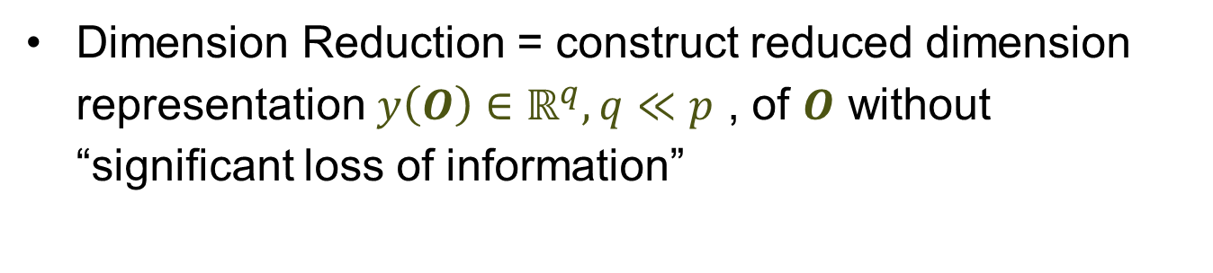
We need dimension reduction
High dimensionality $p$ of $X(O)$ is critical for efficient learning
We can visualize only in 2D/3D
Dimension Reduction = construct reduced dimension representation $y\left(O\right)∈ℝ^{q}, q≪p$ , of $O$ without “significant loss of information”

Slide 6
There are various purposes for usage of dimension reduction
Visualization
Data compression
“curse of dimensionality”
De-noising
Reasonable distance metrics

Slide 7
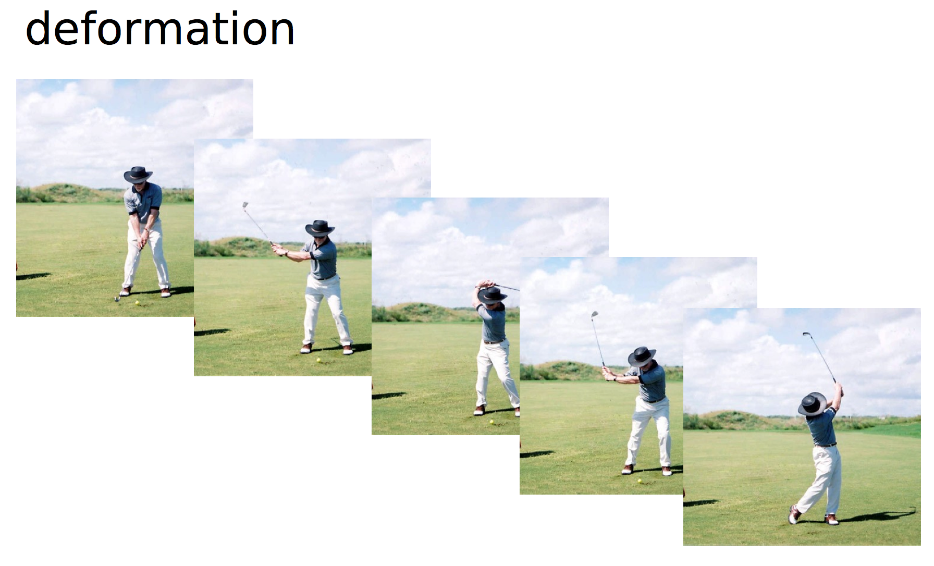
What is “a smart distance”?
Деформация

Slide 8
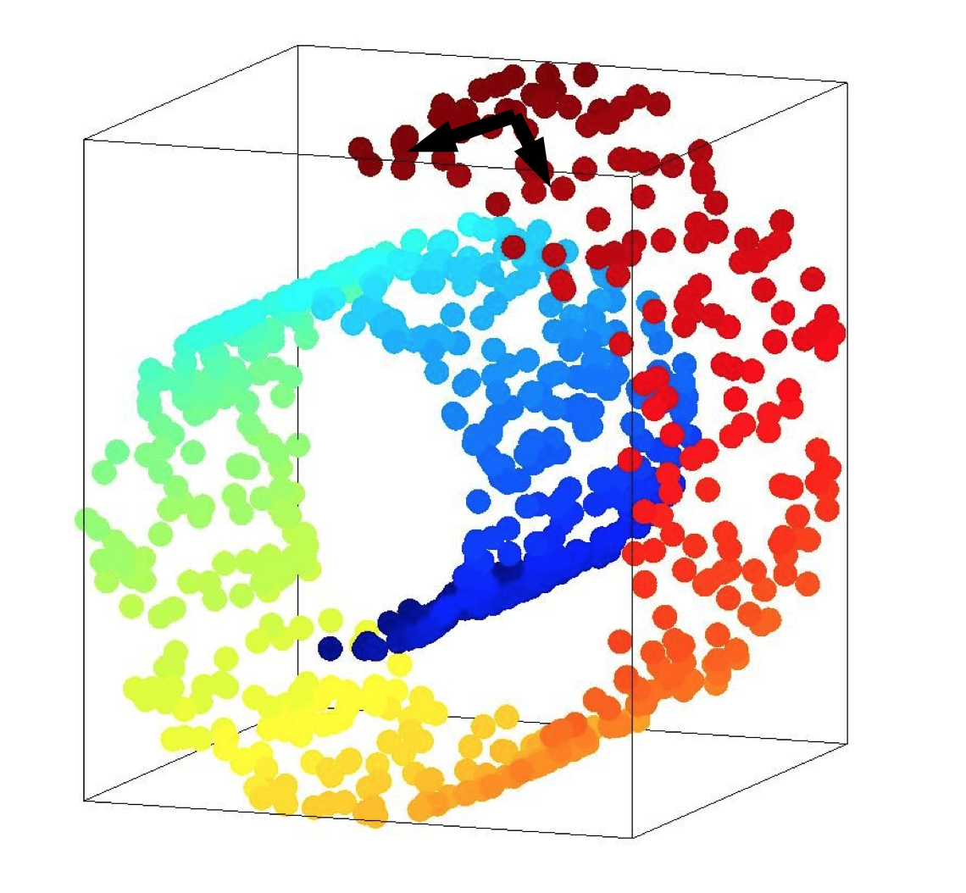
What is “a smart distance”?

Slide 9
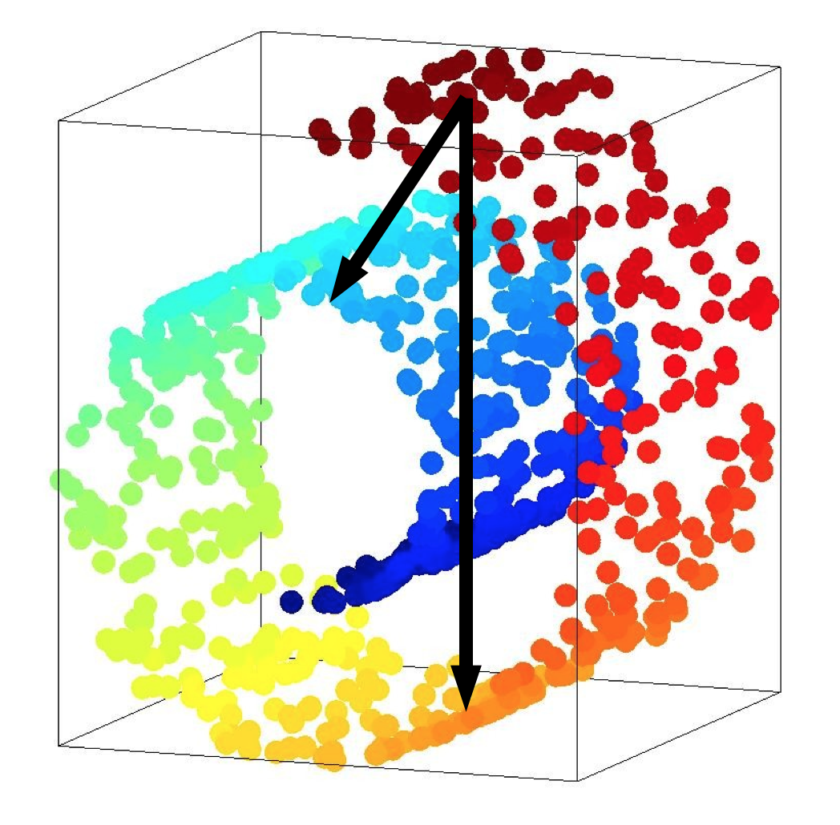
What is “a smart distance”?

Slide 10
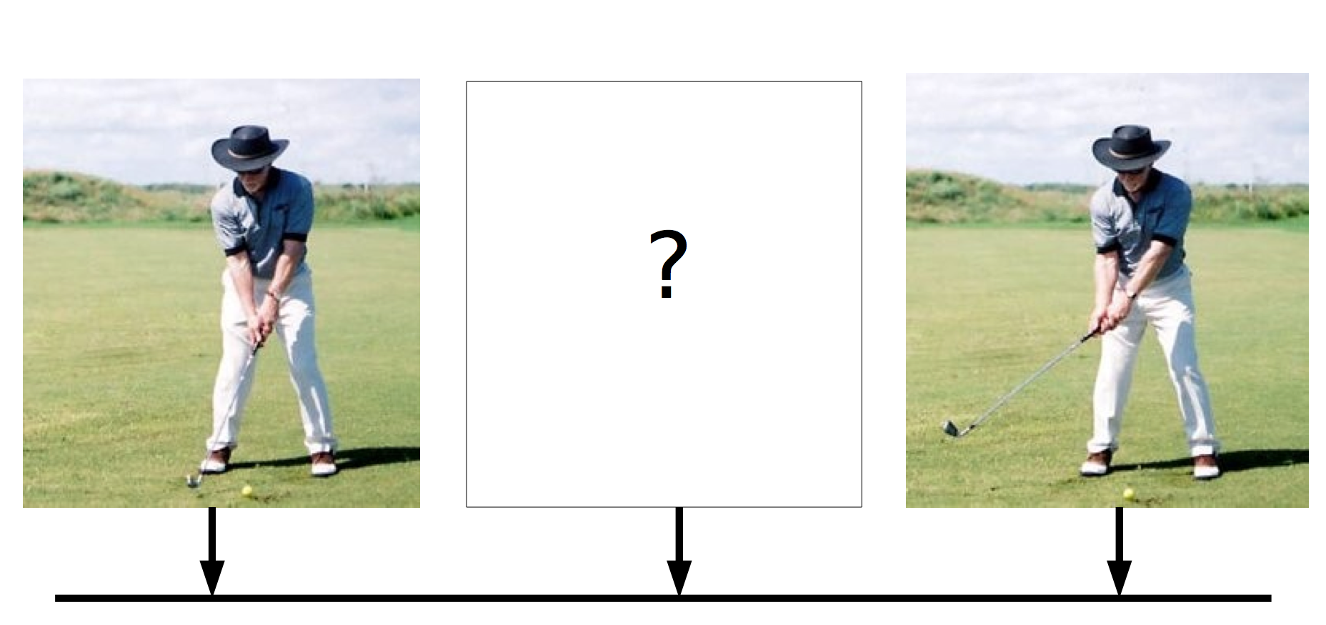
Smart distance

Slide 11
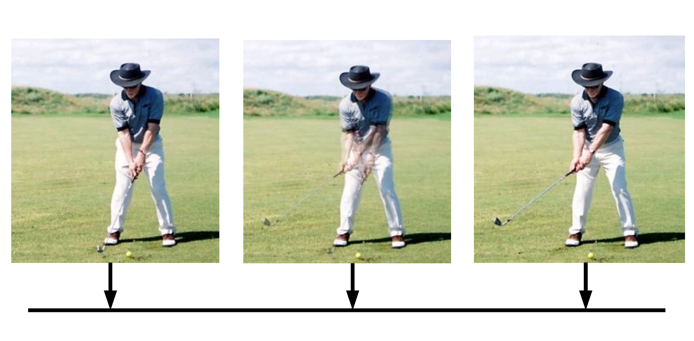
Smart distance
Linear interpolation

Slide 12
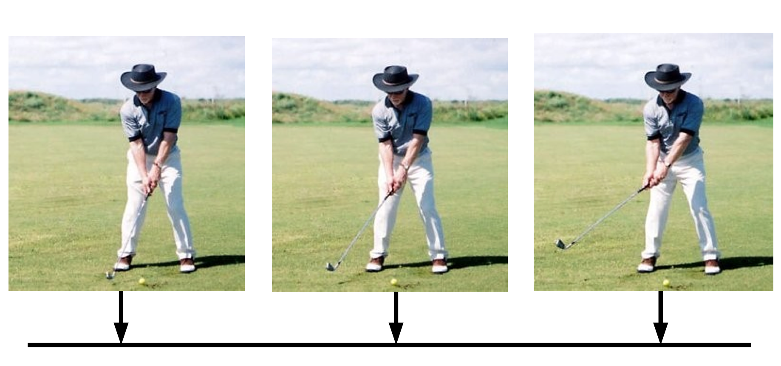
Smart distance
Manifold distance

Slide 13
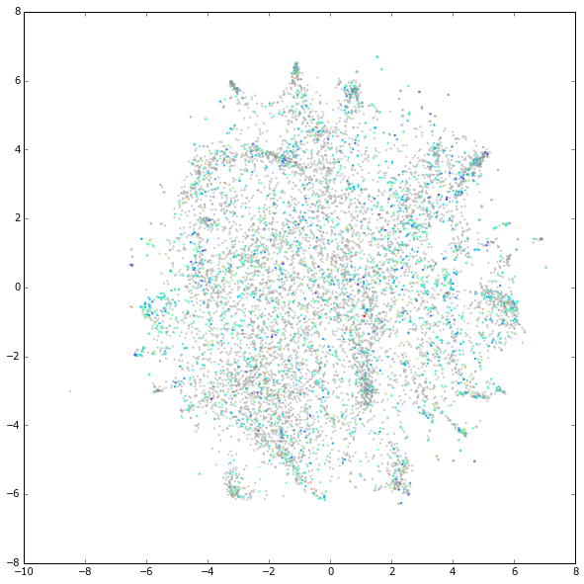
Embedding of images

Slide 14
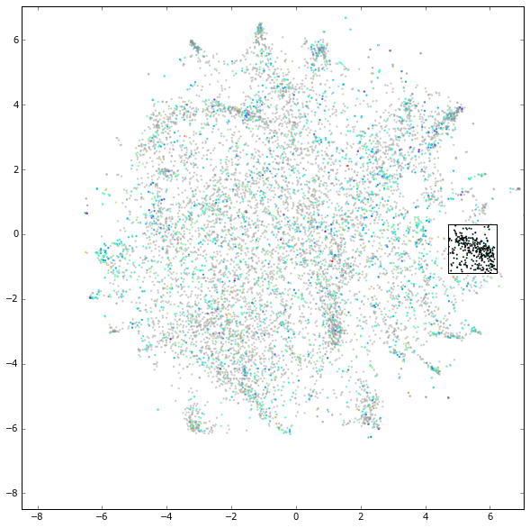
Embedding of images

Slide 15
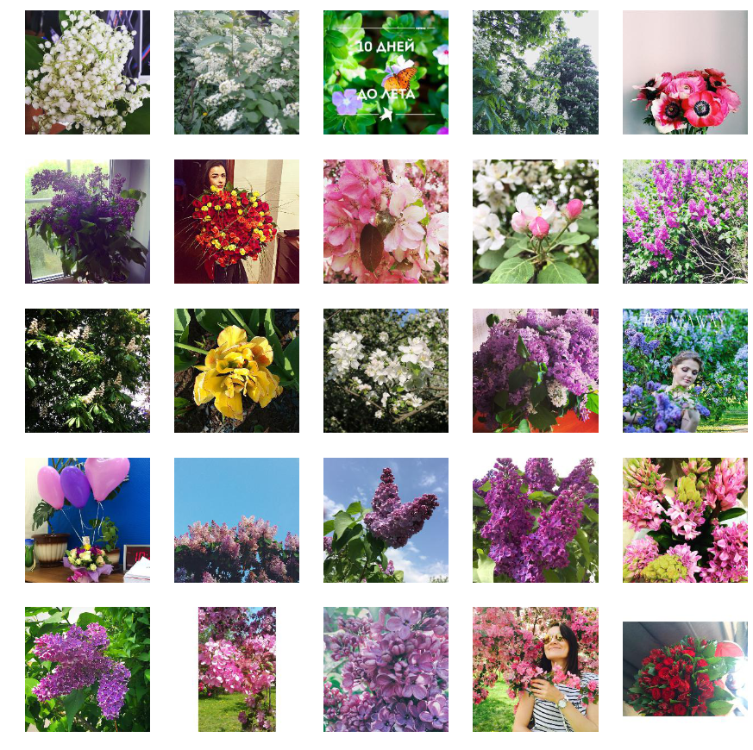
Embedding of images

Slide 16
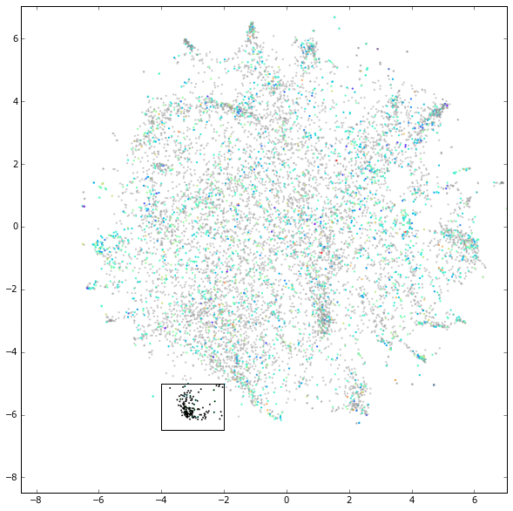
Embedding of images

Slide 17
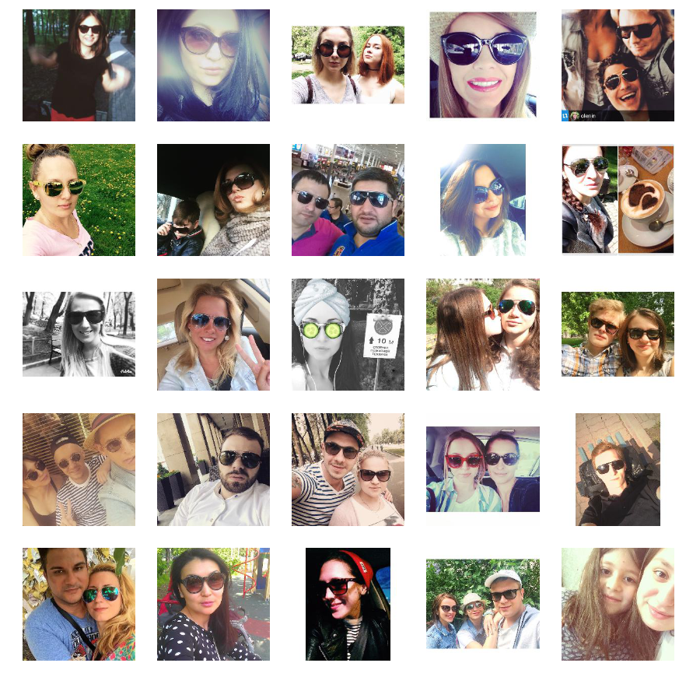
Embedding of images

Slide 18
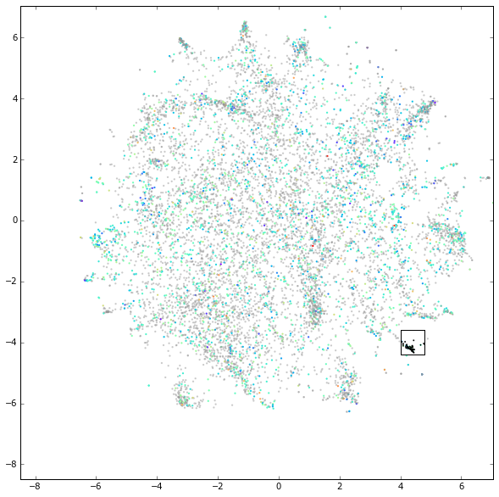
Embedding of images

Slide 19
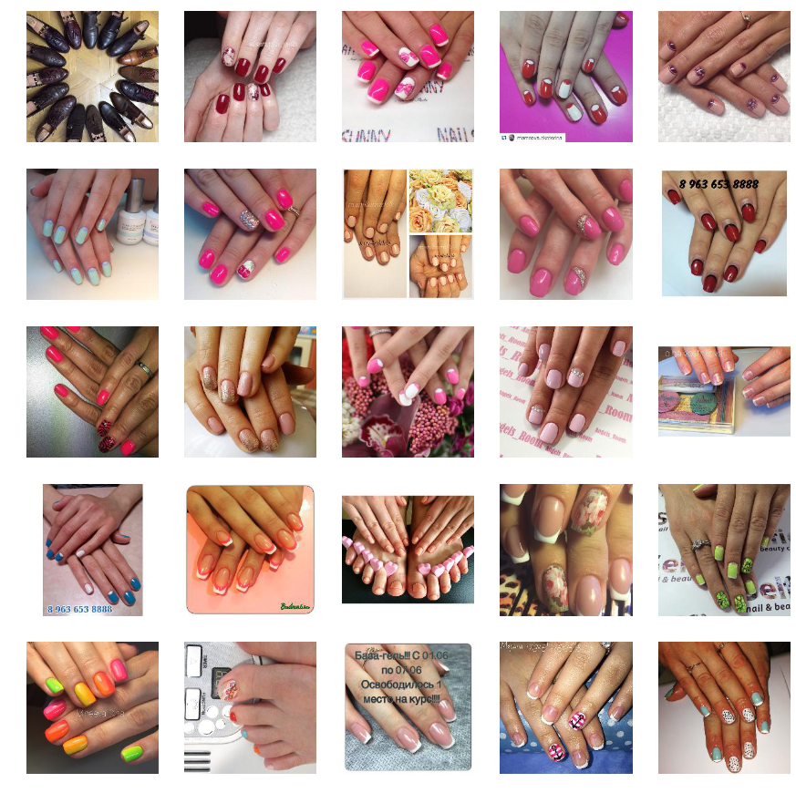
Embedding of images

Slide 20
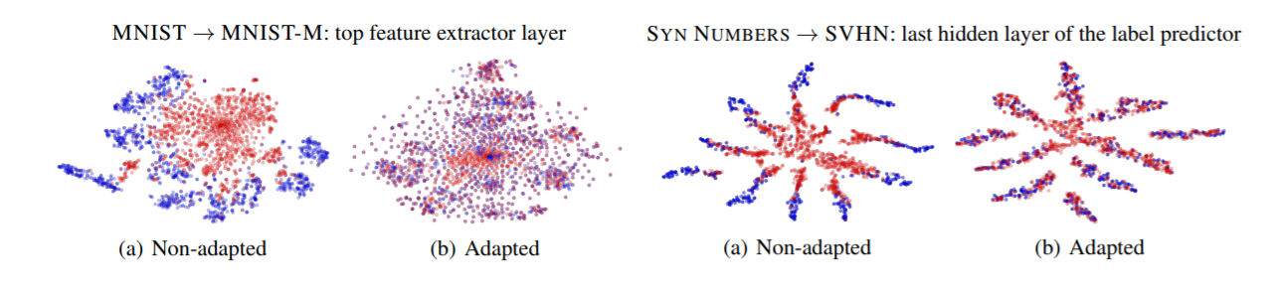
How and how well does our domain adaptation work?
Ganin, Yaroslav, and Victor Lempitsky. "Unsupervised domain adaptation by backpropagation." arXiv preprint arXiv:1409.7495 (2014).
MSCVS2011: V. Lempitsky, Skoltech - Writing a computer vision paper https://youtu.be/-Oq8AHIC92A
How to Write a Great Research Paper, S.P. Jones, Microsoft Research. https://youtu.be/WP-FkUaOcOM

Slide 21
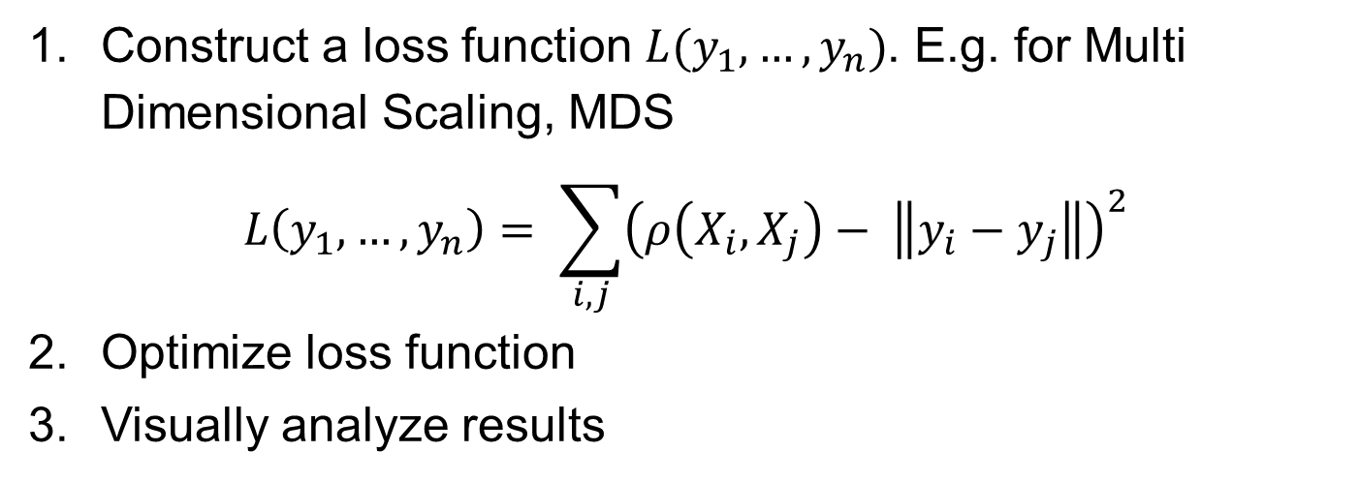
Typical scheme for dimension reduction
Construct a loss function $L(y_{1}, …, y_{n})$. E.g. for Multi Dimensional Scaling, MDS
$$L\left(y_{1},…, y_{n}\right)= \sum_{i, j}{{\left(ρ\left(X_{i}, X_{j}\right)− \left\|y_{i}−y_{j}\right\|\right)}^{2}}$$
Optimize loss function
Visually analyze results
Popular embedding methods:
Principal Component Analysis (PCA)
Kernel PCA, KPCA
Locally Linear Embedding, LLE; Conformal Eigenmaps
Laplacian Eigenmaps, Hessian Eigenmaps
ISOmetric MAPing, ISOMAP
Local Tangent Space Alignment, LTSA

Slide 22
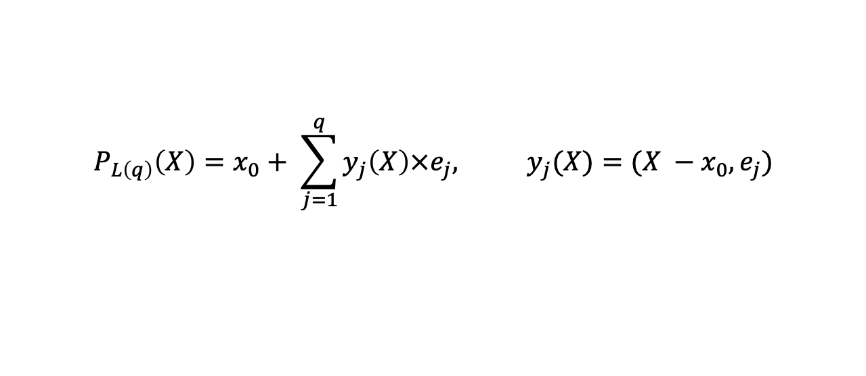
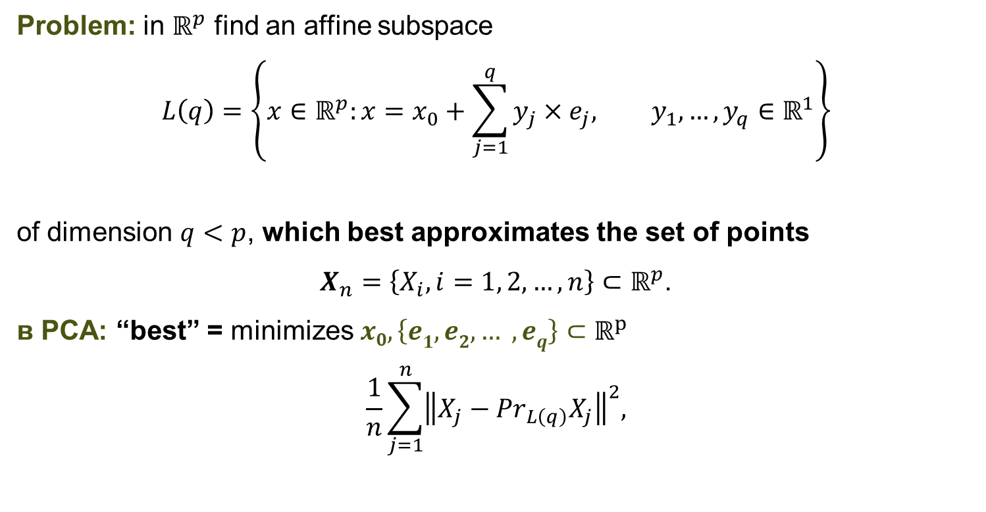
Principal Component Analysis (PCA)
Problem: in $ℝ^{p}$ find an affine subspace
$$L\left(q\right)=\left\{x∈ℝ^{p}:x=x_{0}+\sum_{j=1}^{q}{y_{j}×e_{j}, y_{1}, …,y_{q}∈ℝ^{1}}\right\}$$
of dimension $q<p$, which best approximates the set of points
$X_{n}=\left\{X_{i}, i=1, 2,…,n\right\}⊂ℝ^{p}$.
в PCA: “best” = minimizes $x0, \left\{e1, e2, … , eq\right\}⊂ℝ^{p}$
$$\frac{1}{n}\sum_{j=1}^{n}{{\left\|X_{j}−{Pr}_{L\left(q\right)}X_{j}\right\|}^{2},}$$
$$P_{L\left(q\right)}\left(X\right)=x_{0}+ \sum_{j=1}^{q}{y_{j}\left(X\right)×e_{j}, y_{j}(X)=(X −x_{0},e_{j})}$$

Slide 23
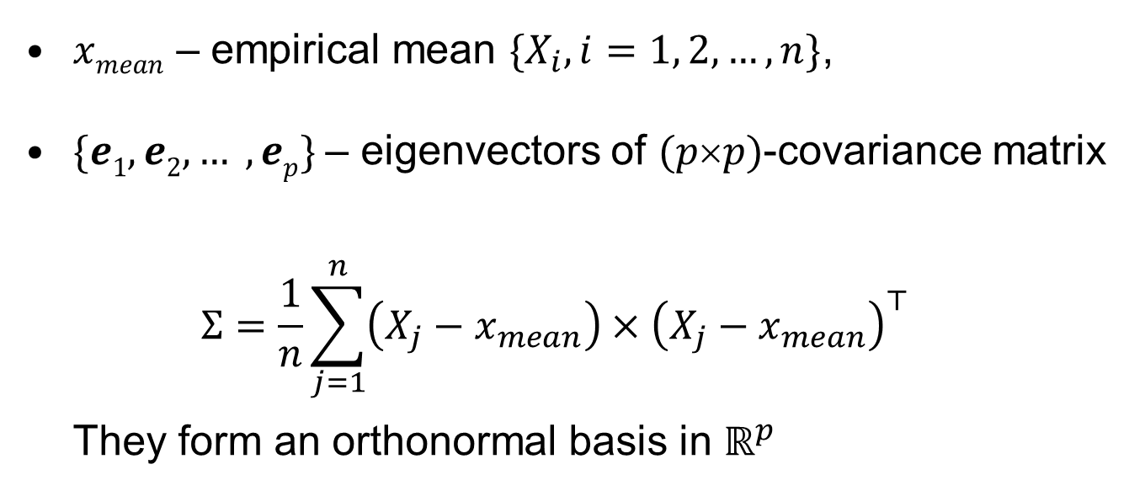
Principal Component Analysis (PCA)
$xmean$ – empirical mean $\{X_{i}, i=1, 2, …, n\}$,
$\{e1, e2, … , ep\}$– eigenvectors of $(pp)$-covariance matrix $Σ=\frac{1}{n}\sum_{j=1}^{n}{\left(X_{j}−x_{mean}\right)×{\left(X_{j}−x_{mean}\right)}^{⊤}}$ They form an orthonormal basis in $ℝ^{p}$

Slide 24
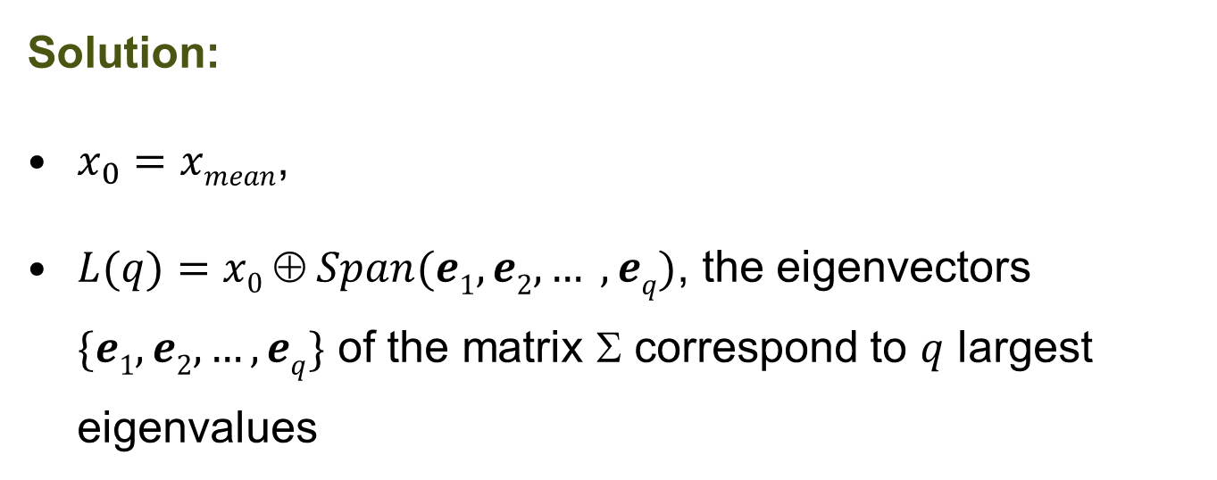
Example: $p=2, q=1$
I₂
e₂
e₁
$$L(1)=\{X∈ℝ^{2}:X=x_{0}+y×e_{1}, y∈ℝ^{1}\}$$
x₀
Solution:
$x_{0}=xmean$,
$L(q)=x0  Span(e1, e2, … , eq)$, the eigenvectors $\{e1, e2, …, eq\}$ of the matrix Σ correspond to $q$ largest eigenvalues
I₁

Slide 25
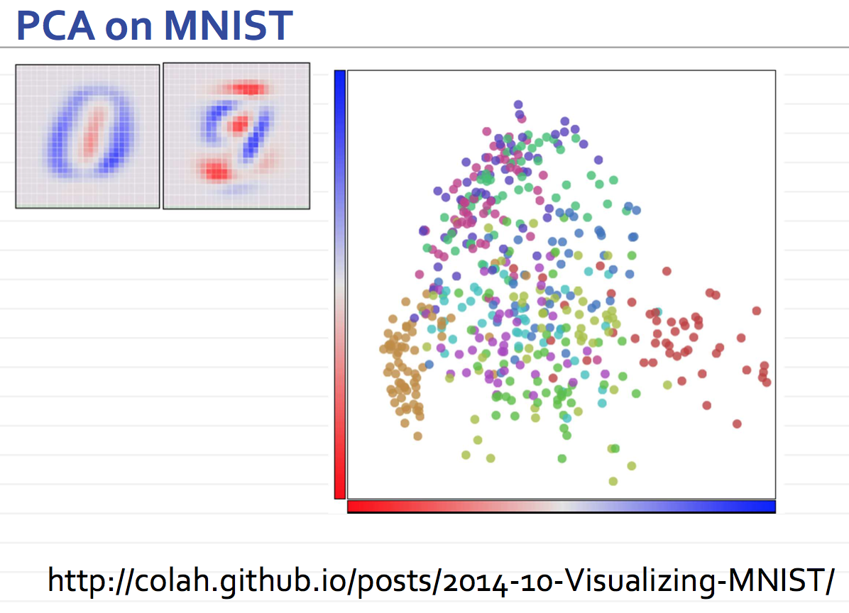
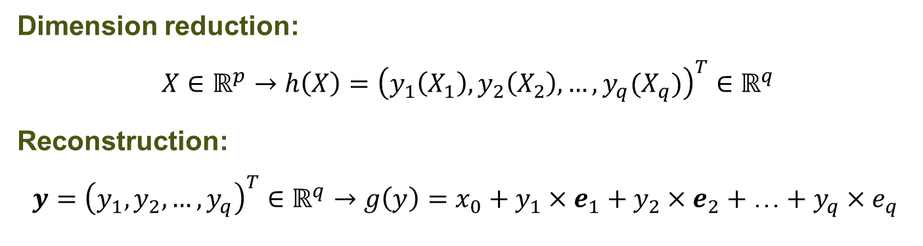
PCA solves the full dimension reduction problem
Dimension reduction:
$$X∈ℝ^{p}→h\left(X\right)={\left(y_{1}\left(X_{1}\right), y_{2}\left(X_{2}\right), …,y_{q}(X_{q})\right)}^{T}∈ℝ^{q}$$
Reconstruction:
$$y={\left(y_{1}, y_{2}, …,y_{q}\right)}^{T}∈ℝ^{q}→g\left(y\right)=x_{0}+y_{1}×e_{1}+y_{2}×e_{2}+…+y_{q}×e_{q}$$
PCA for MNIST

Slide 26
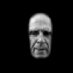
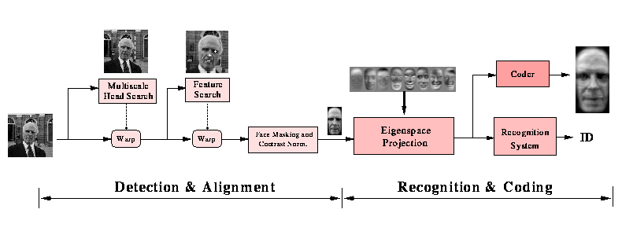
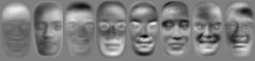

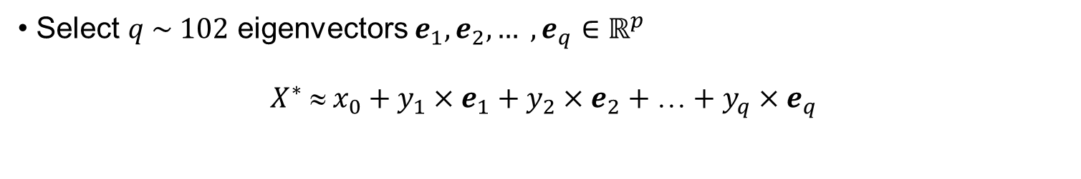
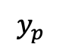
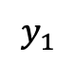
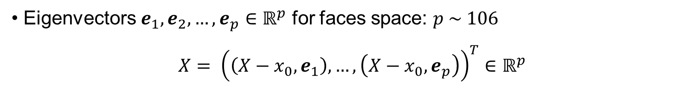
PCA for face recognition
Eigenvectors $e_{1}, e_{2}, …, e_{p}∈ℝ^{p}$ for faces space: $p \sim 106$
$$X= {\left(\left(X−x_{0},e_{1}\right), …, \left(X−x_{0}, e_{p}\right)\right)}^{T}∈ℝ^{p}$$
$$y_{1}$$
$$y_{p}$$
Select $q \sim 102$ eigenvectors $e_{1}, e_{2}, … , e_{q}∈ℝ^{p}$
$$X^{∗}  x_{0}+y_{1}×e_{1}+y_{2}×e_{2}++y_{q}×e_{q}$$
$$y1e1 y2e2 y3e3 y4e4 y5e_{5} y6e_{6} y7e7 y8e8$$

Slide 27
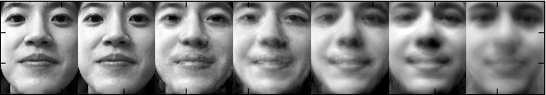
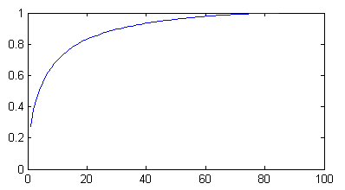
PCA for face recognition
From the left to the right: reconstruction using 84, 40, 20, 3, 2, and 1 dimensions.
Variance
Dimensionality

Slide 28

PCA for face recognition
PCA is a linear approach to dimension reduction
It was quite popular before 2000s
The idea is to find the best projections

Slide 29
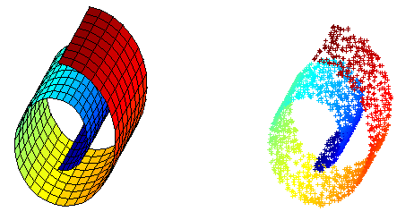
PCA fails in a nonlinear setting

Slide 30
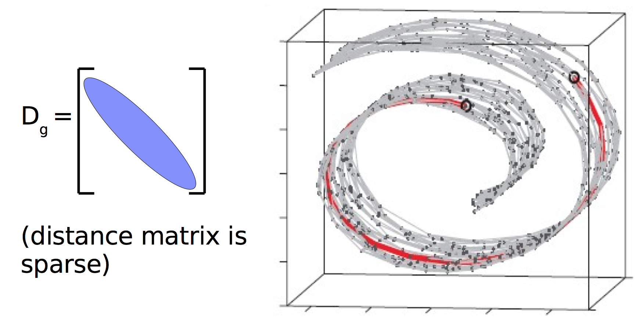
ISOMAP
1. Construct sparse k nearest neighbors graph

Slide 31
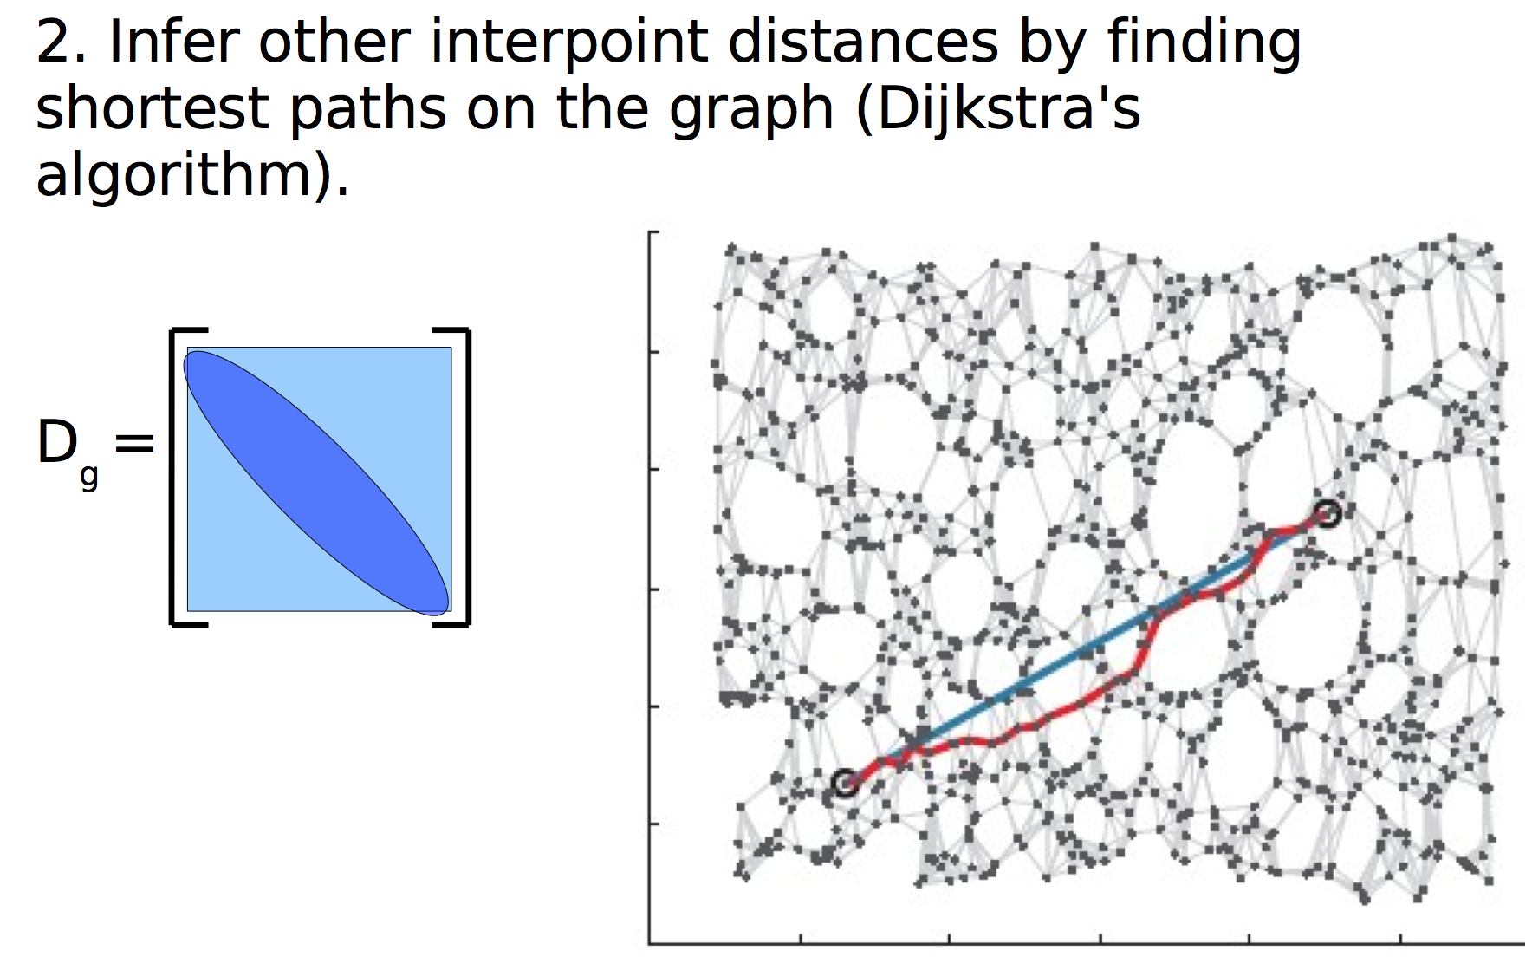
ISOMAP

Slide 32
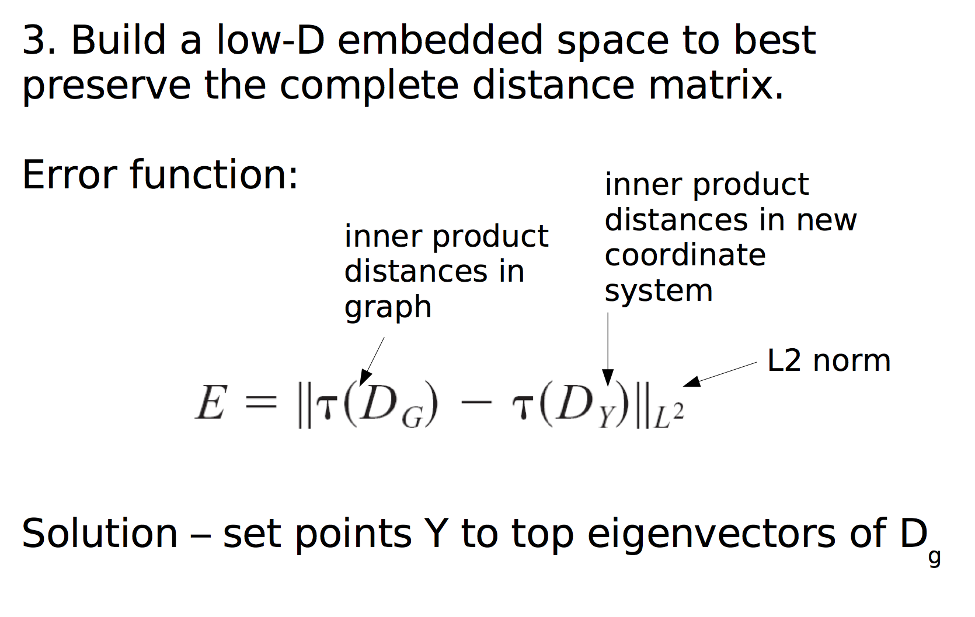
ISOMAP
3. MDS: find low-dimensional embedding, that preserves distance matrix
Error function:

Slide 33
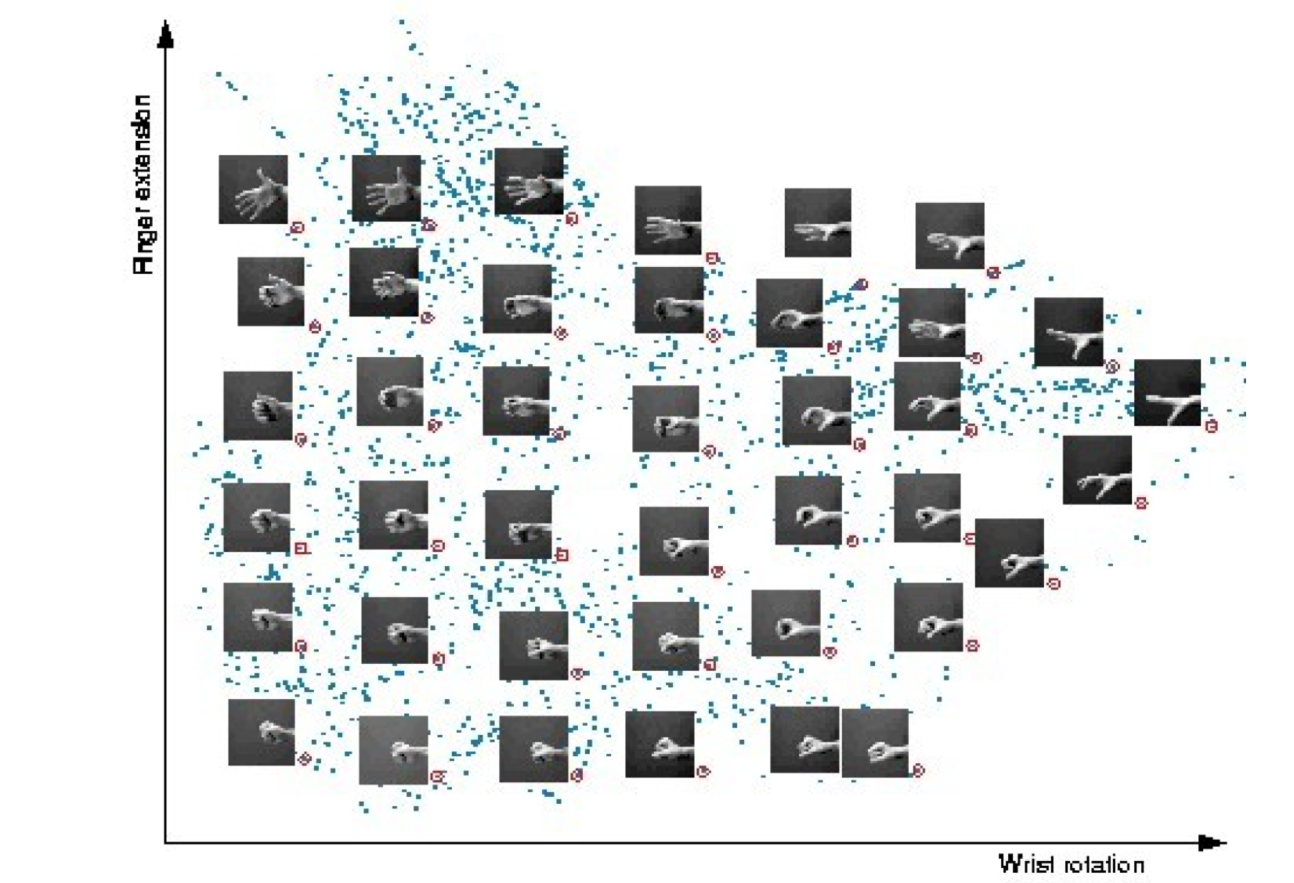
ISOMAP results: hands embedding

Slide 34
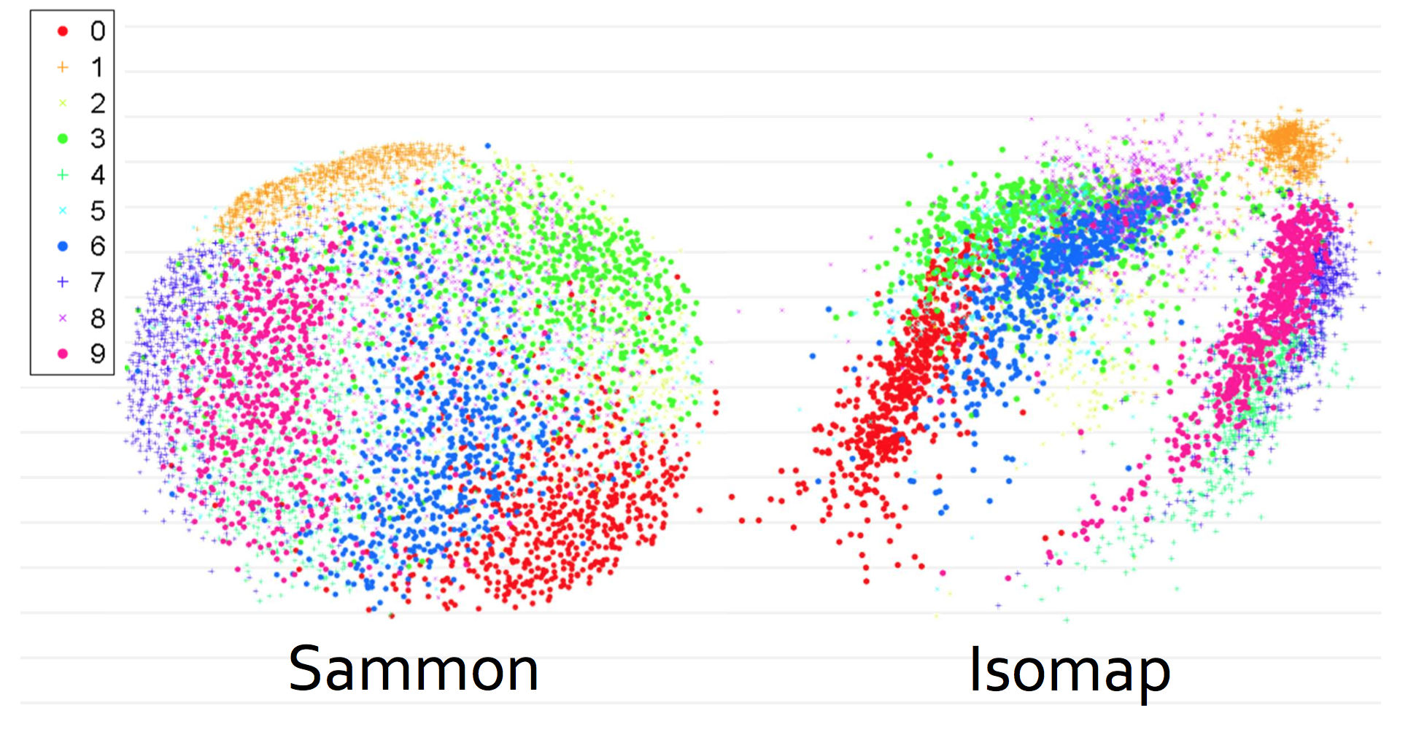
MNIST: Linear approach vs. ISOMAP

Slide 35
Pros and cons of ISOMAP
Preserves global structure
Small number of parameters
Sensitive to noise, noisy edges
Computationally expensive: requires eigenvectors and eigenvalues of a dense matrix

Slide 36
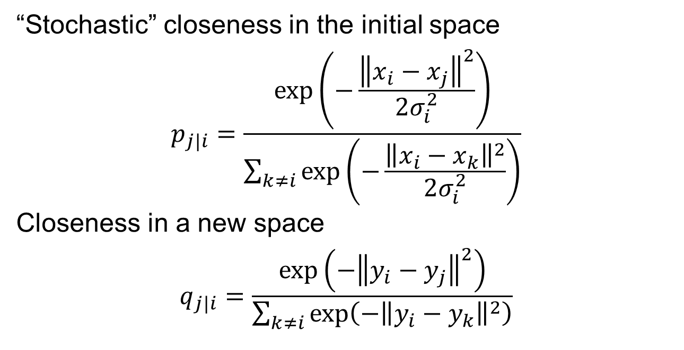
Stochastic neighbours embedding (SNE)
“Stochastic” closeness in the initial space
$$p_{j|i}=\frac{\exp\left(−\frac{{\left\|x_{i}−x_{j}\right\|}^{2}}{2σ_{i}^{2}}\right)}{\sum_{k≠i}{\exp\left(−\frac{{\left\|x_{i}−x_{k}\right\|}^{2}}{2σ_{i}^{2}}\right)}}$$
Closeness in a new space
$$q_{j|i}=\frac{\exp\left(−{\left\|y_{i}−y_{j}\right\|}^{2}\right)}{\sum_{k≠i}{\exp\left(−{\left\|y_{i}−y_{k}\right\|}^{2}\right)}}$$

Slide 37
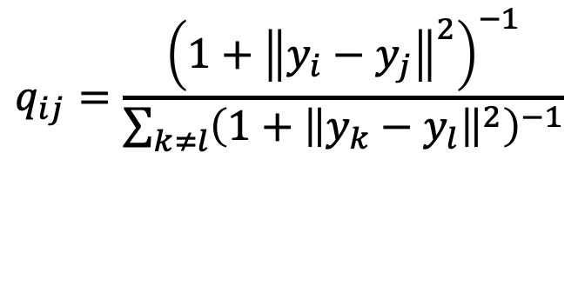
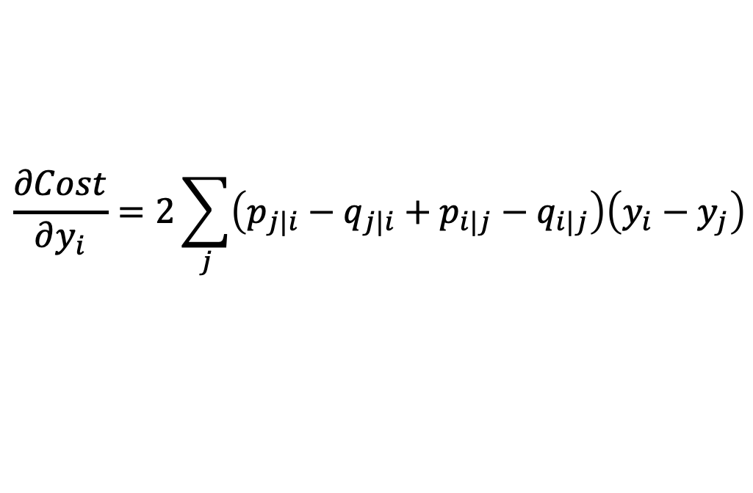
t-SNE
“Stochastic” closeness in the initial space
$$\frac{∂Cost}{∂y_{i}}=2\sum_{j}{\left(p_{j|i}−q_{j|i}+p_{i|j}−q_{i|j}\right)\left(y_{i}−y_{j}\right)}$$
^{To avoid local optimum:}
• Initialize with Gaussian noise
• Add noise of decreasing variance at each step
t-SNE: define closeness on the base of $t\left(1\right)$ distribution
$$q_{ij}=\frac{{\left(1+{\left\|y_{i}−y_{j}\right\|}^{2}\right)}^{−1}}{\sum_{k≠l}{{\left(1+{\left\|y_{k}−y_{l}\right\|}^{2}\right)}^{−1}}}$$
37
37

Slide 38
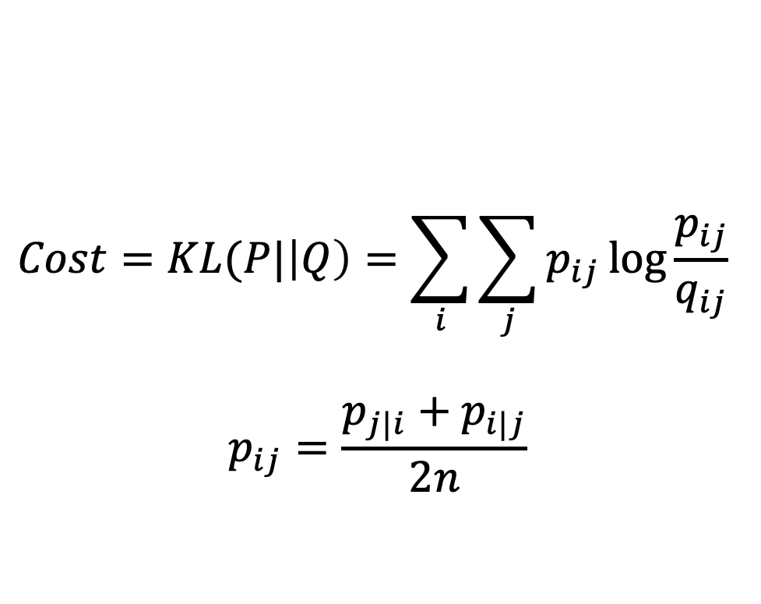
t-SNE
t-sne: minimize KL between P and Q
$$Cost=KL(P|\left|Q\right)=\sum_{i}{\sum_{j}{p_{ij}\log{\frac{p_{ij}}{q_{ij}}} }}$$
$$p_{ij}=\frac{p_{j|i}+p_{i|j}}{2n}$$
38
38

Slide 39

t-SNE for MNIST is good!

Slide 40
Pros and cons of tSNE
Pros:
works surprisingly well in 2D/3D visualization
Provide nonlinear embedding
Cons:
quite slow
Requires retraining if new points are added

Slide 41

No Free Lunch
For more complex manifolds you need more complex data

Slide 42

There are many other approaches
https://scikit-learn.org/stable/auto_examples/manifold/plot_compare_methods.html

Slide 43



Dimension reduction: take home messages
Start with tSNE – it works surprisingly good
PCA helps if data is linear
There are also neural networks based embeddings
https://towardsdatascience.com/what-the-heck-are-vae-gans-17b86023588a

